Slide 1
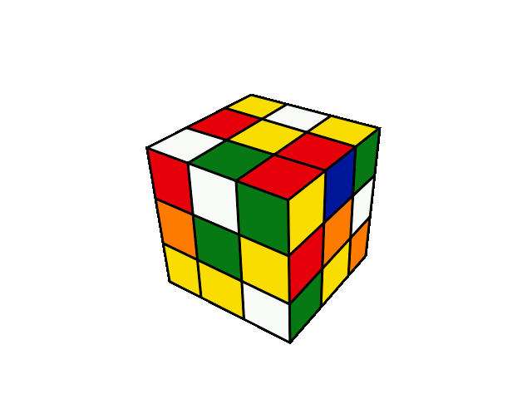
What color is this?

Slide 2
blue

Slide 3
green

Slide 4
red

Slide 5
black

Slide 6
pink

Slide 7
yellow

Slide 8
white

Slide 9
orange

Slide 10
grey

Slide 11
brown

Slide 12
purple

Slide 13
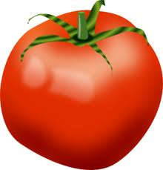
heart
red
tomato

Slide 14
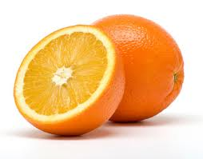
carrot
orange

Slide 15
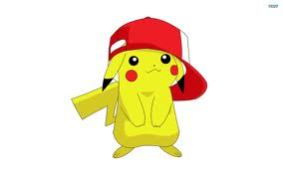
yellow
banana

Slide 16
green
vegetable
grass

Slide 17
blue
sea
sky

Slide 18
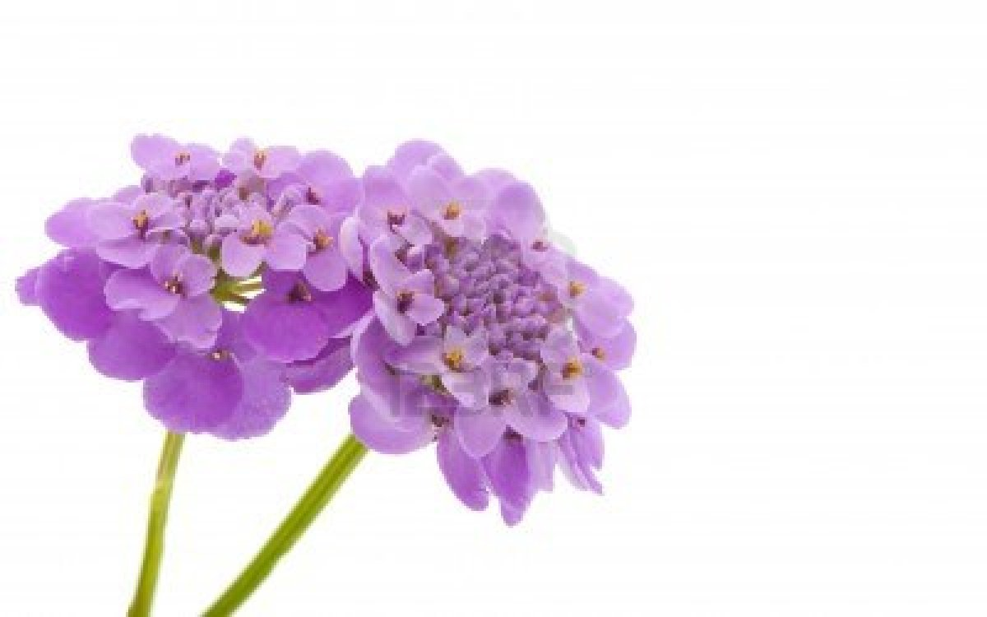
grapes
purple
flower

Slide 19
pink
lips

Slide 20
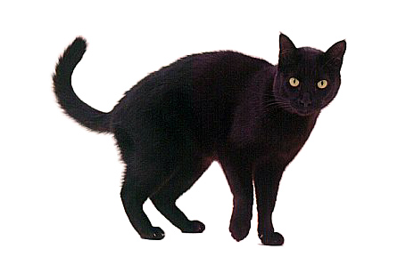
board
black
cat

Slide 21
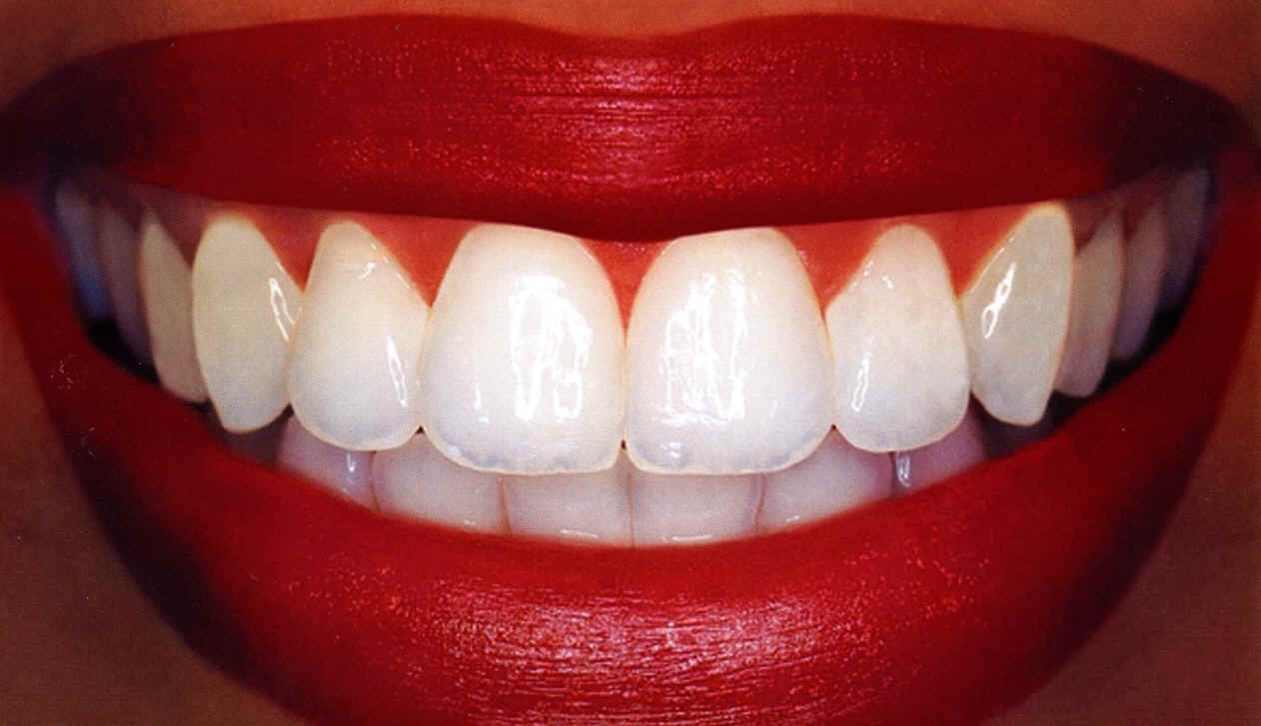
white
teeth

Slide 22
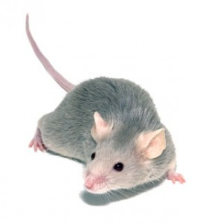
grey
goat
mouse

Slide 23
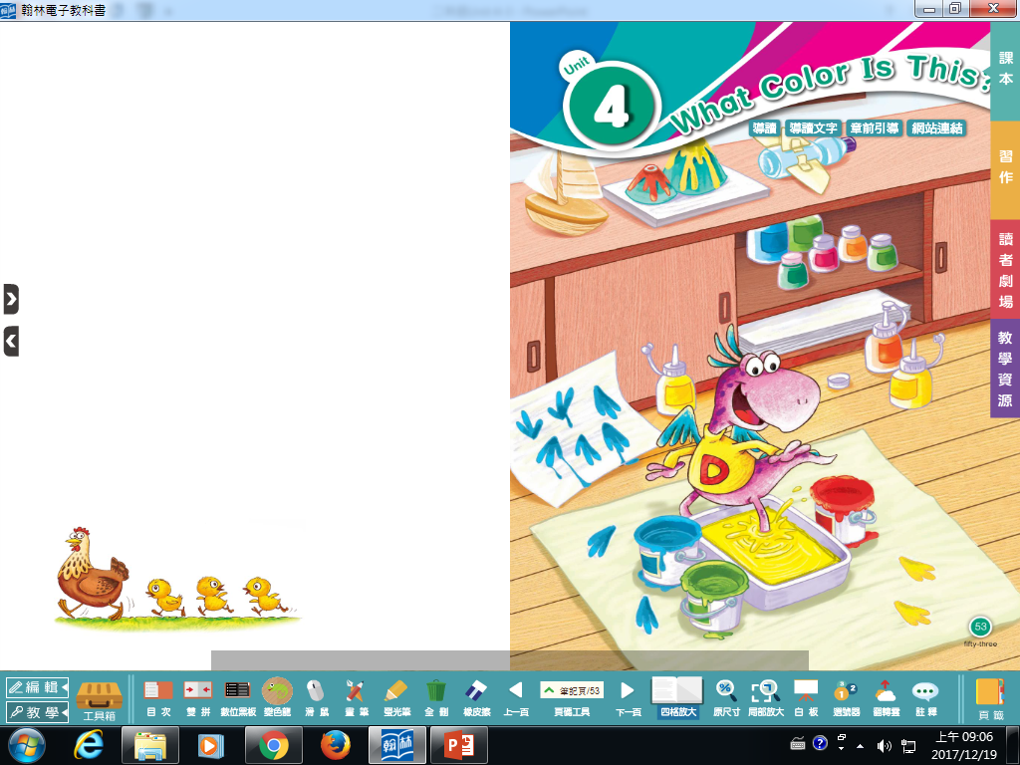

Slide 24
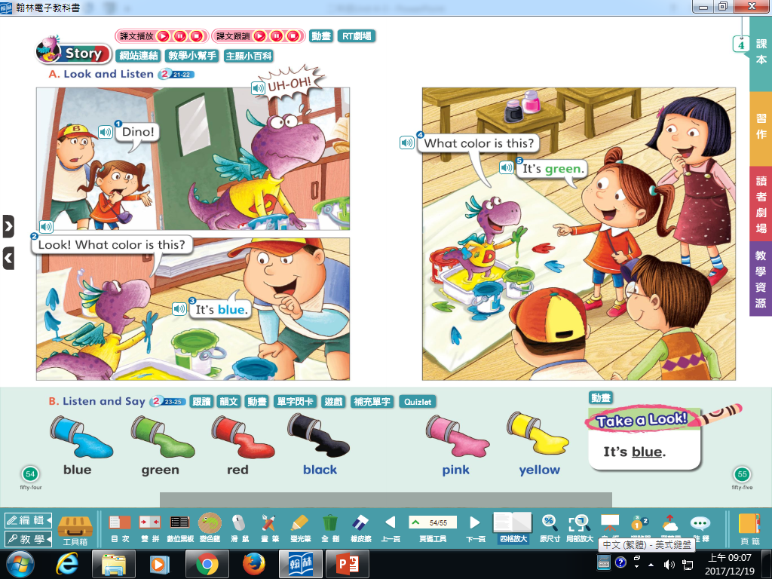
看

Slide 25
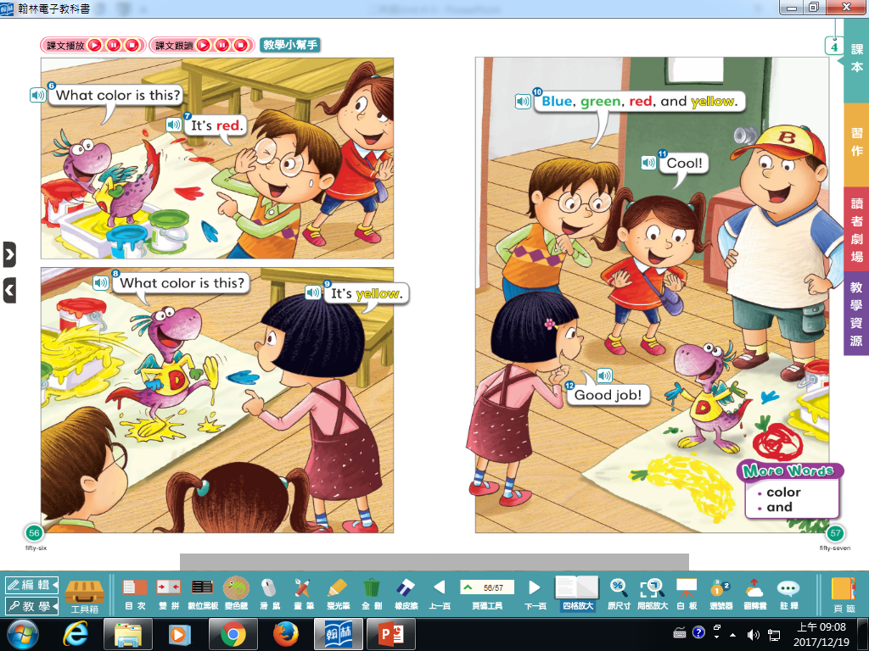
酷
做得好

Slide 27
Listen and Draw

